Slide 1
CAPSTONE PROJECT
Mentor: dorababu sir
TEAM-6:
Sabyasachi MISHRA
Vyshnavi Tummuri
Sarvasuddi kanaka Ratnam
Tannu Priya
Falak qureshi

Slide 2
CONTENTS
Objective
Problem Statement
Tools and Technology
Scenarios
Output

Slide 3
OBJECTIVE
https://demoqa.com/
Our main objective is to test the provided website using various technologies.
The given link is of SELENIUM CERTIFICATION TRAINING.
In this, We have different types to test like: Live classes, Weekend sessions, Assignments and also the Recorded classes.

Slide 4
PROBLEM STATEMENT
Here, We are given with more information in the link above.
They are like: Elements, Forms, Alerts & Frame Windows, Widgets, Interactions and the Book store application.
Now, Let us see some cases we worked on.

Slide 5



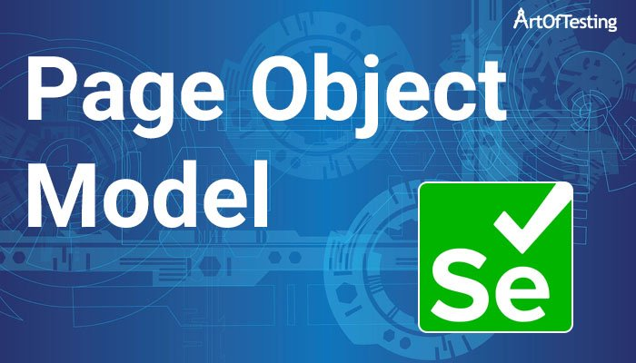



TOOLS AND TECHNOLOGY

Slide 6
SCENARIOS
Testing the functionalities of DEMOQA:
Home page testing
Book store application
Accessing element option
What is inside text box
What is inside check box
Check logo

Slide 7
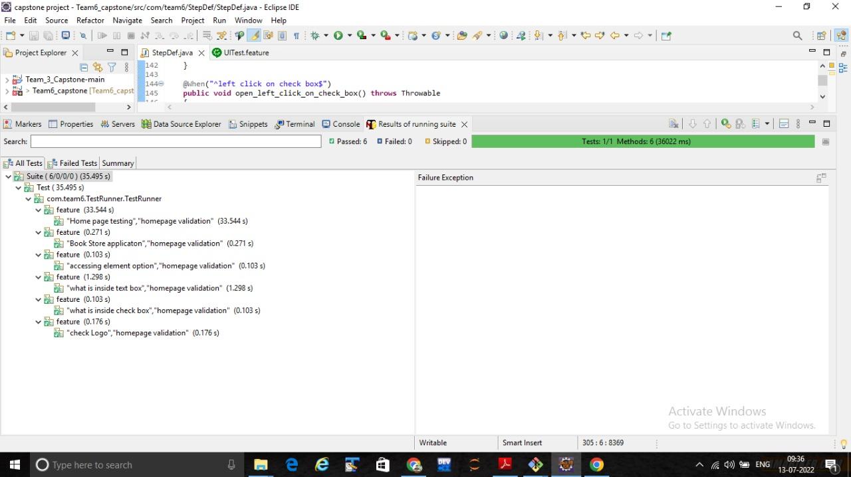
OUTPUT

Slide 8
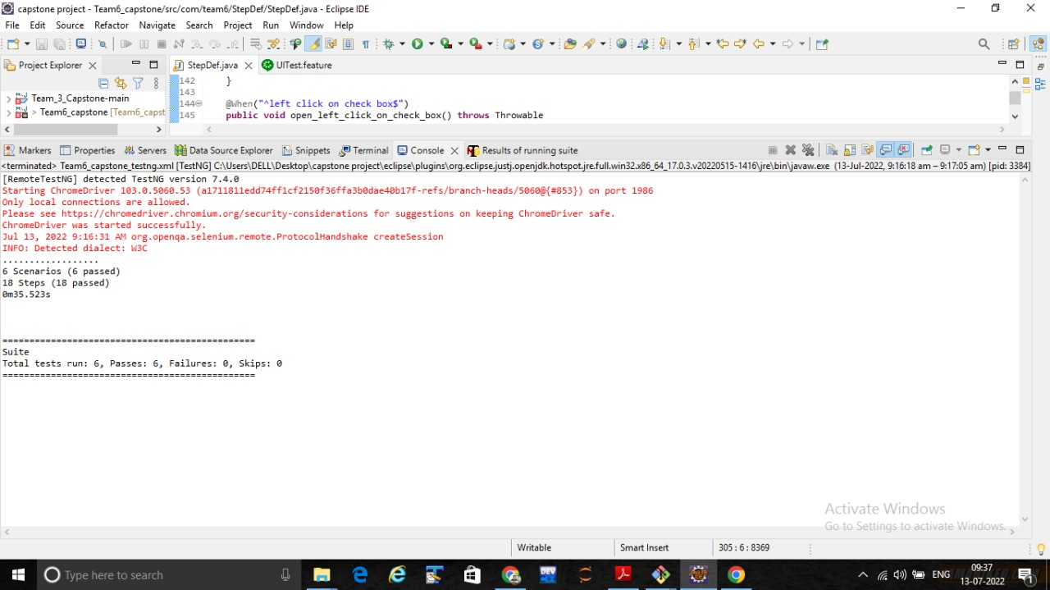

Slide 9
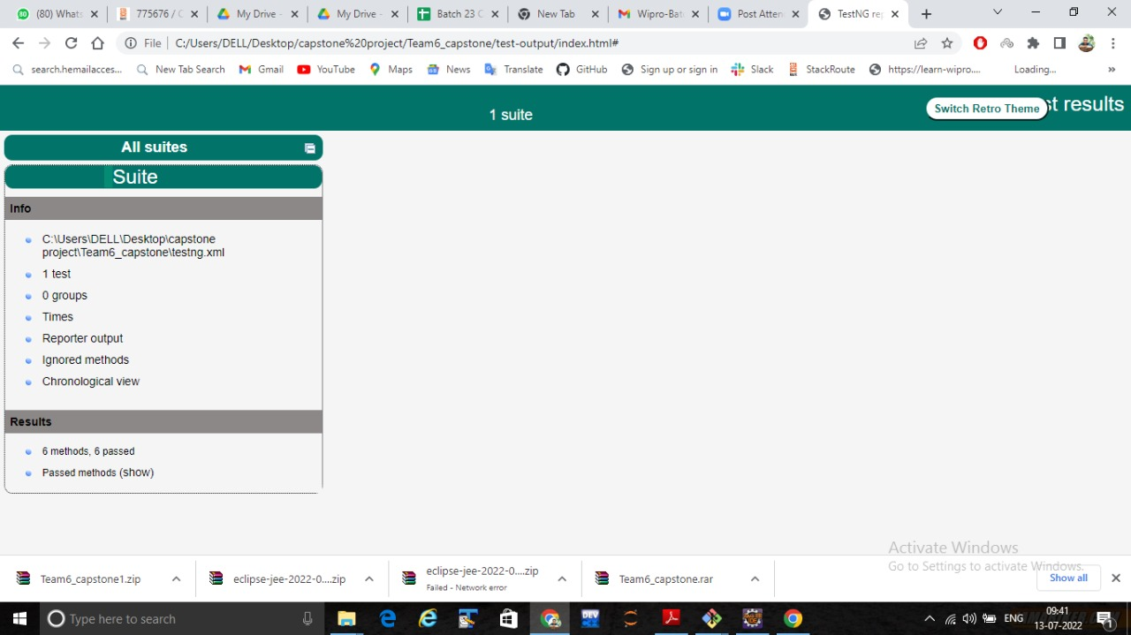

Slide 10
THANK YOU

